Slide 1
Advanced Client-Side Development
Advanced JavaScript Concepts
By Ebad Majeed

Slide 2

Advanced JavaScript
Why is it important?
It's necessary to understand these to become more proficient as a developer in modern JavaScript.

Slide 3
Advanced JavaScript
High Level Review
Arrow Functions
The Spread Operator and Rest Parameter Syntax
Destructuring
Map(), filter() and reduce()
Promise

Slide 4
Advanced JavaScript
Prerequisites:
Functions
this keyword
Data Structures
Ternary Conditionals

Slide 5
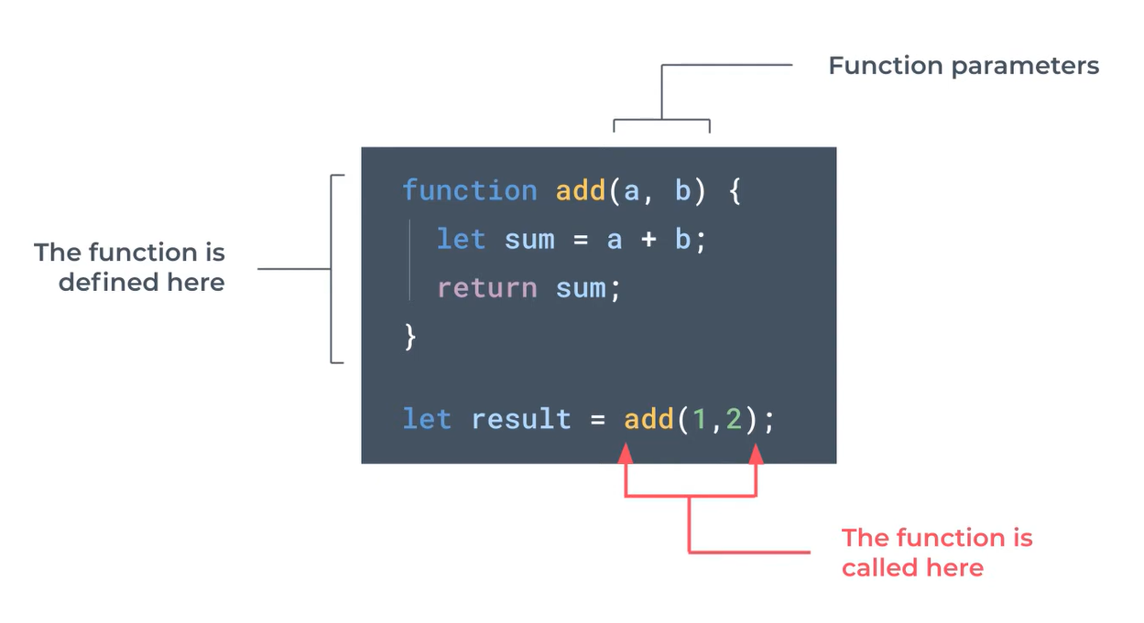
Advanced JavaScript
Normal Function

Slide 6
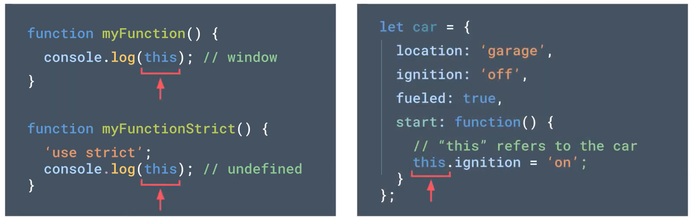
Advanced JavaScript
this keyword
Notes:
Inside a function vs inside a function (strict) vs inside an object

Slide 7
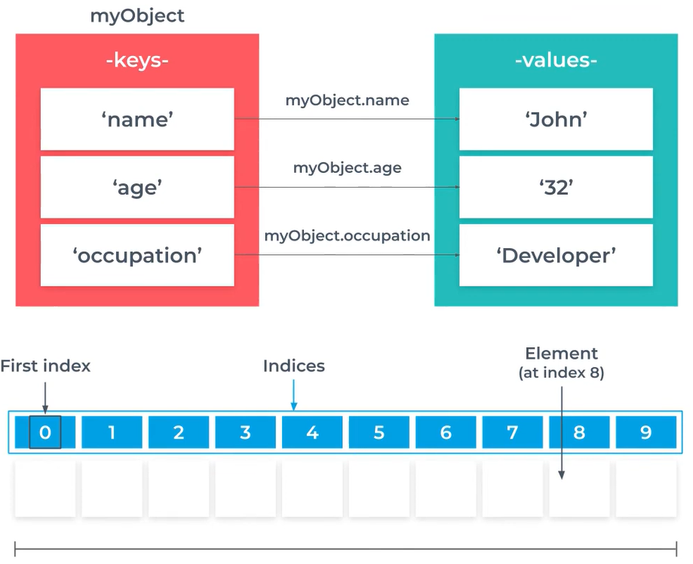
Advanced JavaScript
Data Structures
Arrays
Objects
Notes:
Maps, sets, array of objects etc. are also there

Slide 8
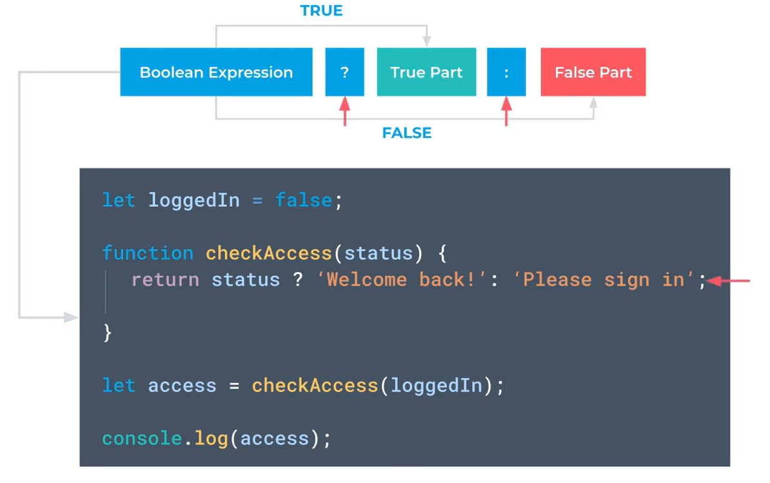
Advanced JavaScript
Ternary Conditional

Slide 9
Advanced JavaScript
Prerequisites Examples

Slide 10
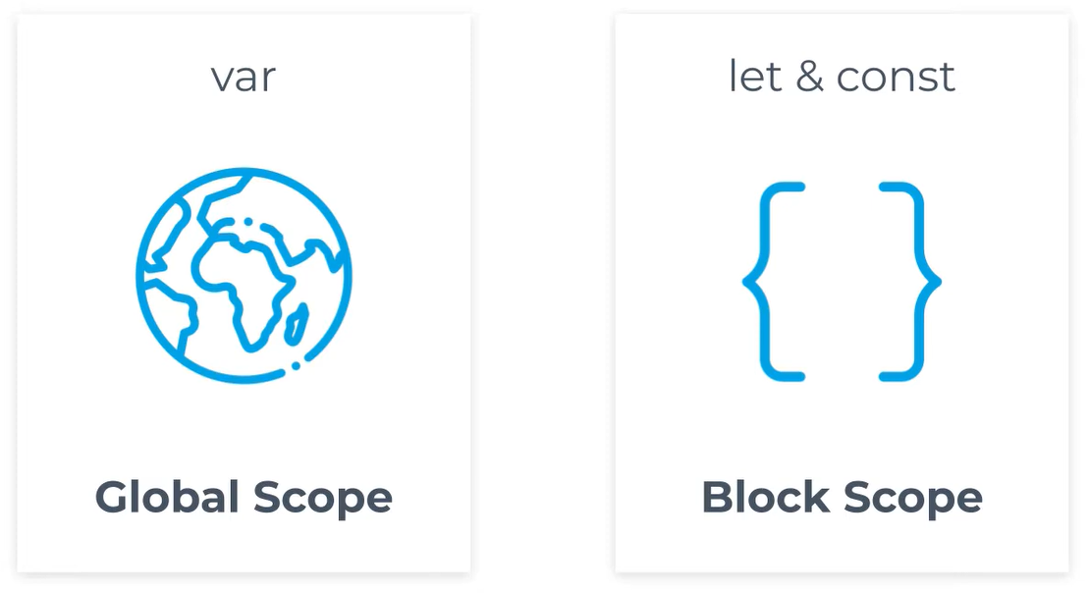
Advanced JavaScript
Var, Let and Const
Notes:
Global vs block scope

Slide 11
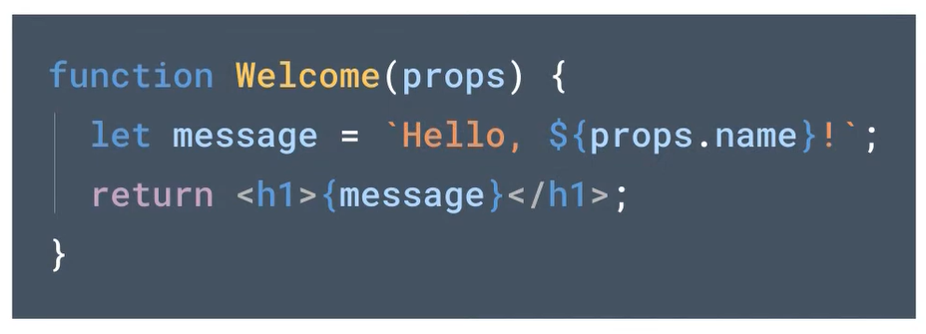
Advanced JavaScript
Template Literals
Notes:
Global vs block scope

Slide 12
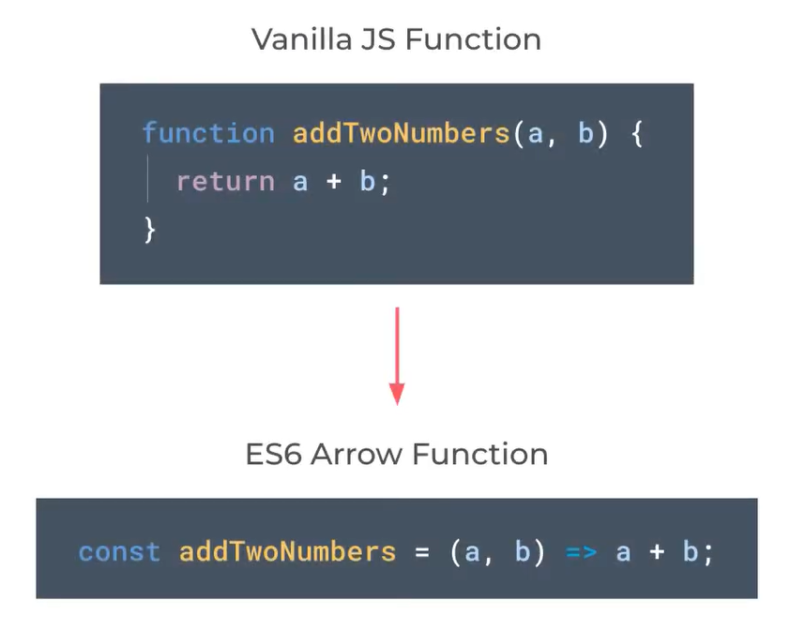
Advanced JavaScript
Arrow Functions
Notes:
Arrow Functions do not have their own this keyword context, so rely on the enclosing scope
ES6 (ECMAScript 2015) is the sixth edition of the ECMAScript language specification, introducing new features like let/const, arrow functions, classes, modules, template literals, and promises.

Slide 13
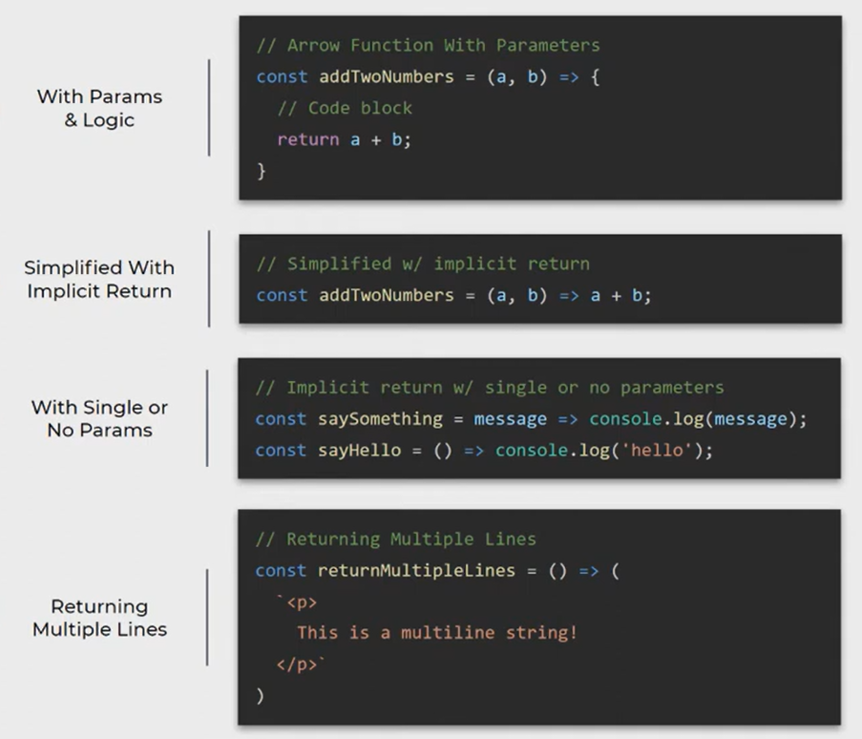
Advanced JavaScript
Different Arrow Functions

Slide 14
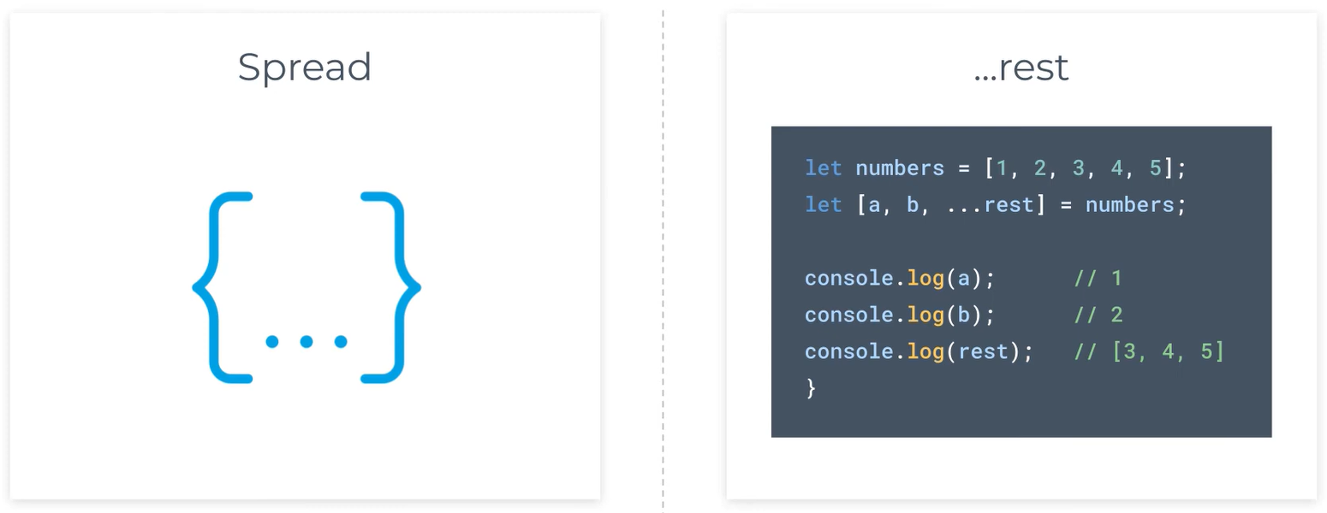
Advanced JavaScript
Spread Operator and rest parameter syntax

Slide 15
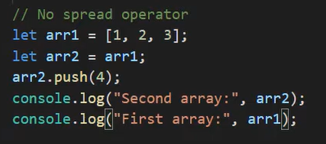
Advanced JavaScript
Need for Spread Operator?
What’s the issue with this code?
Notes:
Shallow Copy vs Deep Copy

Slide 16
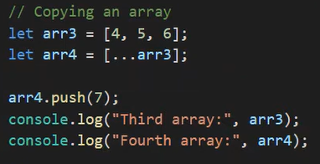
Advanced JavaScript
Solution to shallow copy?

Slide 17
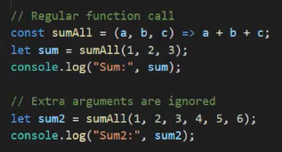
Advanced JavaScript
rest parameter syntax
Need?
Issue?

Slide 18
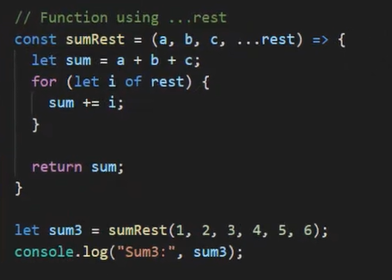
Advanced JavaScript
rest parameter syntax
Solution

Slide 19
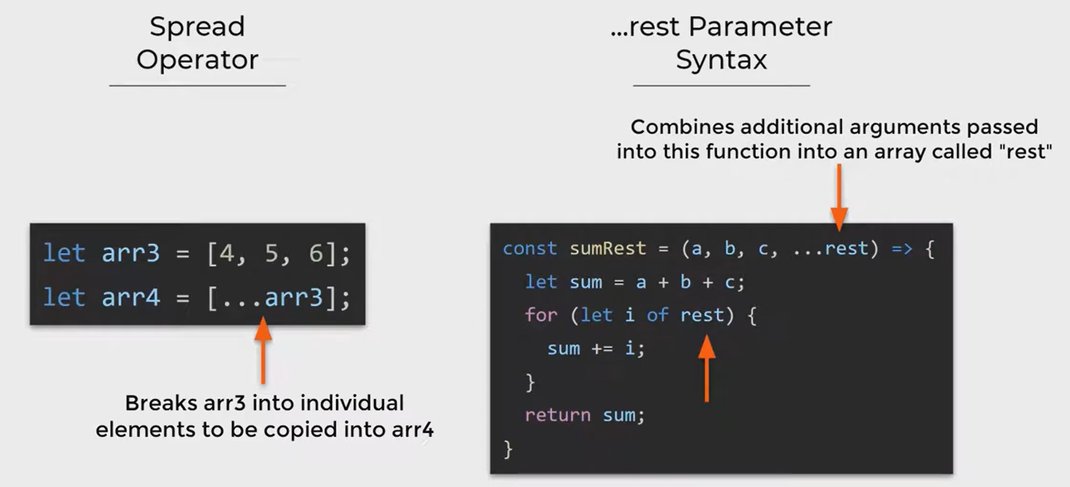
Advanced JavaScript
Spread Operator vs rest parameter syntax

Slide 20
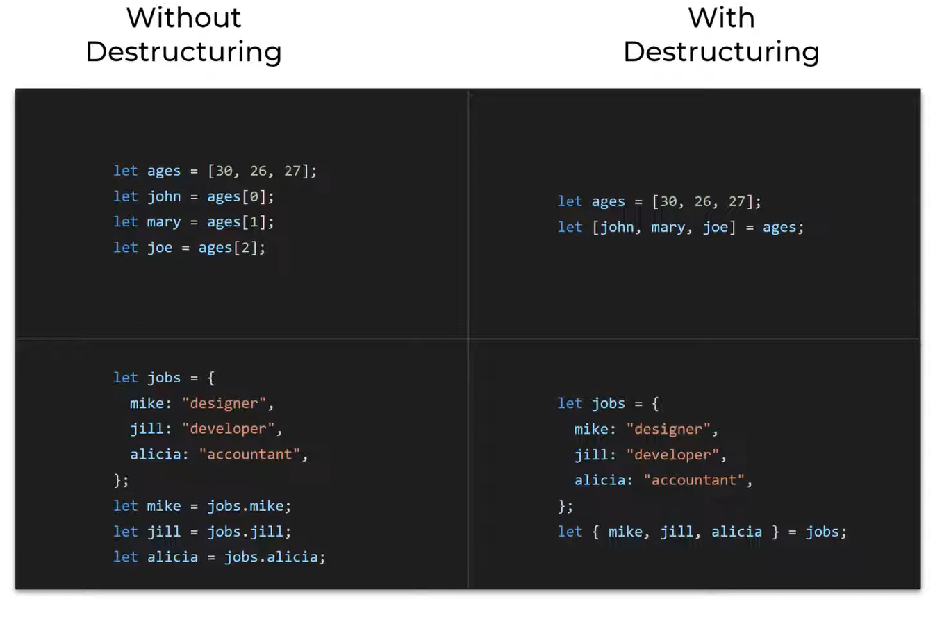
Advanced JavaScript
Destructuring

Slide 21
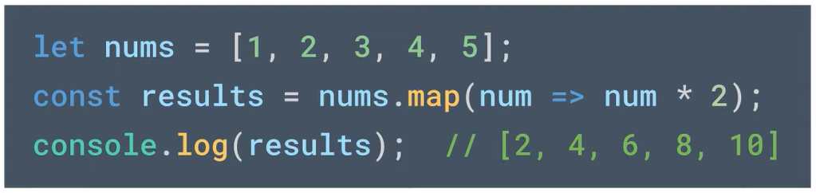
Advanced JavaScript
map()

Slide 22
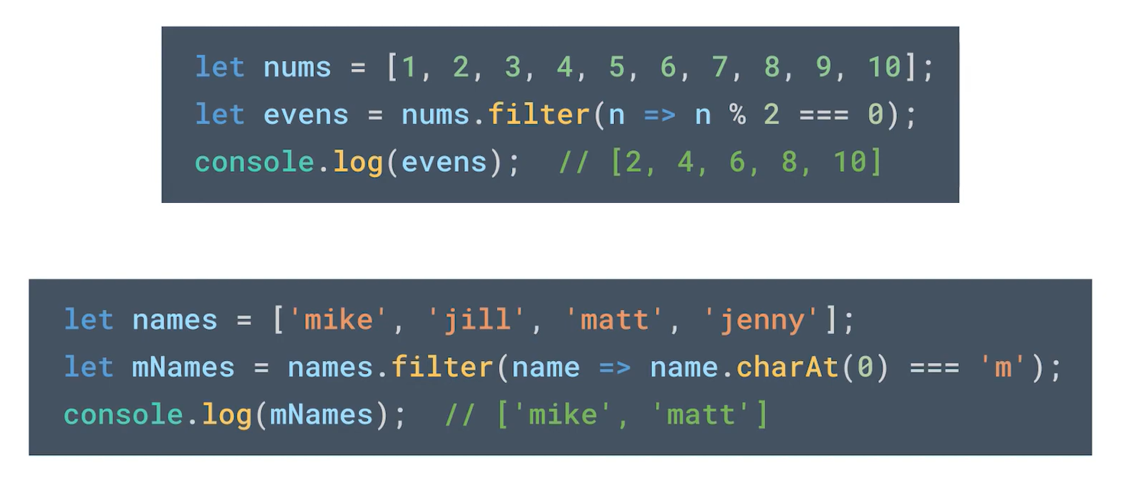
Advanced JavaScript
filter()

Slide 23
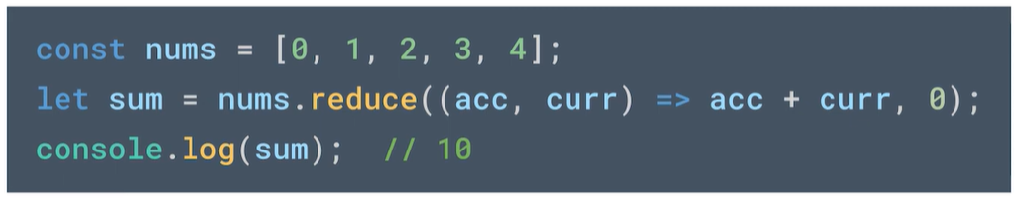
Advanced JavaScript
reduce()
Notes:
0 is for the initial value acc (accumulator), curr is the current element of the array In each iteration: curr gets the next value in the array nums starting from the first till the last

Slide 24
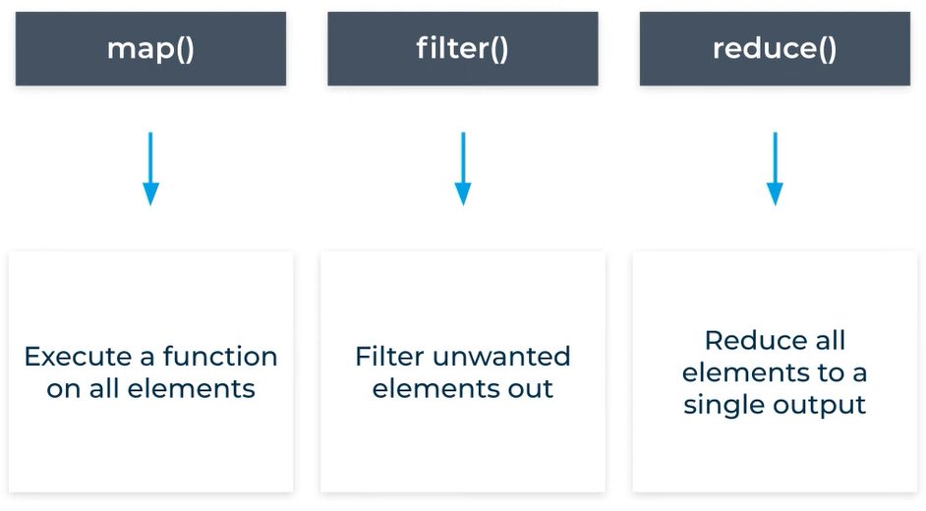
Advanced JavaScript
map() vs filter() vs reduce()

Slide 25
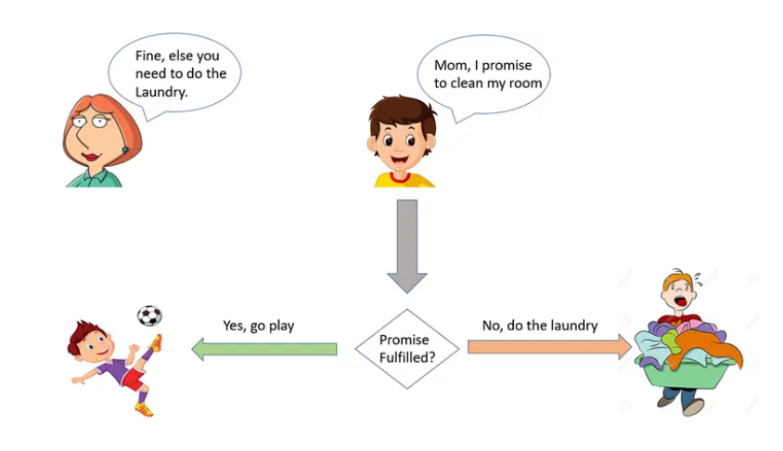
Advanced JavaScript
promise
Notes:
Promise is an object, although creating one involves passing a function src: https://medium.com/@pravngaur/javascript-promises-66685250d657

Slide 26
Advanced JavaScript
Advanced Concepts Examples
Notes:
Promise is an object, although creating one involves passing a function src: https://medium.com/@pravngaur/javascript-promises-66685250d657

Slide 27
Any Questions!

